Slide 1
LESSON FIFTEEN
TOPICS: CREATE AN ANIMATION THAT DISPLAYS THE NUMBER OF BULLETS REMAINING: HOW TO USE MODEL PARTS.

Slide 2
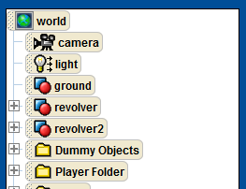
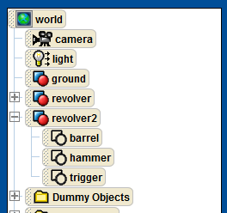
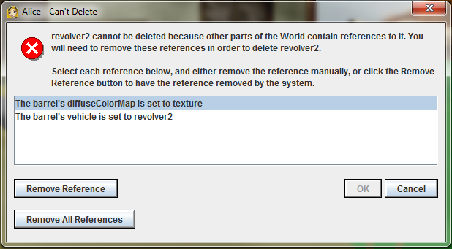
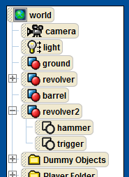
Step 1: Add the barrel Model to the World
Add a new revolver model to the world.
Open up the new revolver model (revolver2), find the barrel sub-model, and move it out of the revolver model and place it under the world object.
Delete the remainder of the revolver2 model. This will cause Alice to throw an error warning. Click on “Remove All References,” and then click on “OK.”

Slide 3
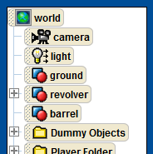
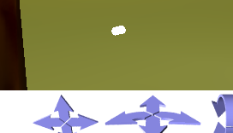
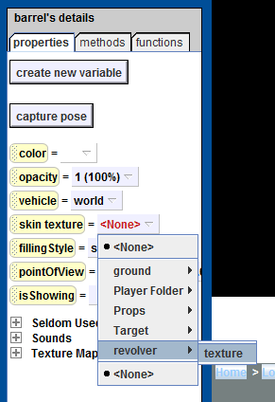
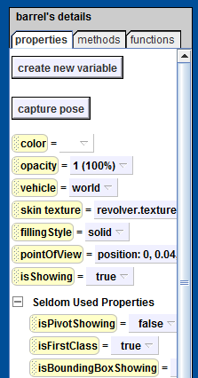
Step 2: Restore the barrel Texture
Verify that the “barrel” from the second revolver is still part of your Alice world. It should show up in the object tree, and show up as a white cylinder in your Alice world.
Under the barrel’s properties page, find the “skin texture” property and set it to that of the first revolver.
Set the barrel.isFirstClass property to true.
Notes:
QUSETION: Why is the barrel all white?
ANSWER: because when we deleted its parent object we also deleted the texture that was associated with it.

Slide 4
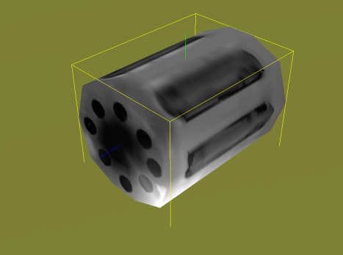
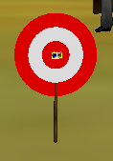
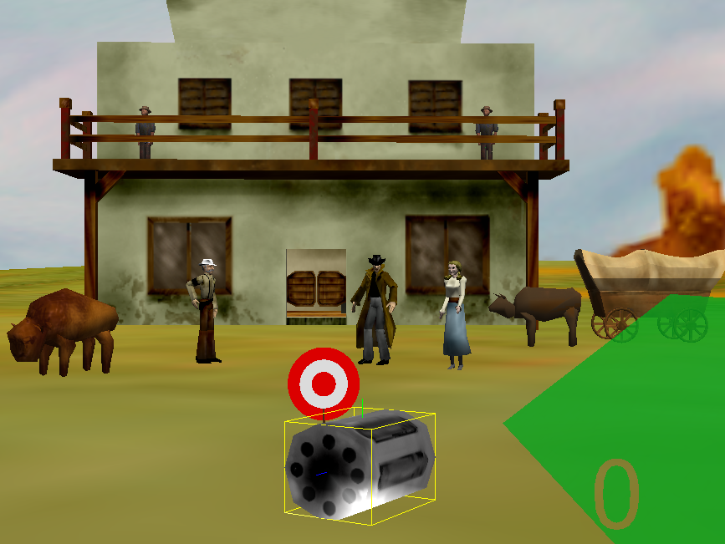
Step 3: Move the barrel into View
Take a closer look at the barrel. It should now have its texture property restored. If it does not, repeat step 2.
Set the camera’s view to PlayerView.
Move the barrel so that it is into view. This can be done by moving it to the Target hitArea and then, making sure that the barrel is selected and not the hitArea, moving the barrel closer to the player.

Slide 5
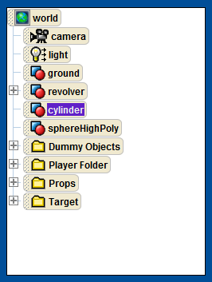
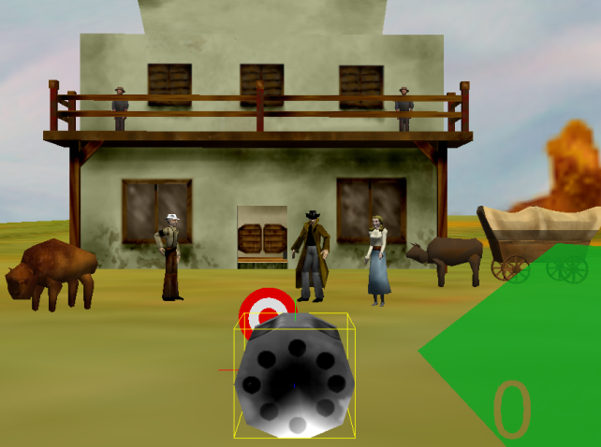

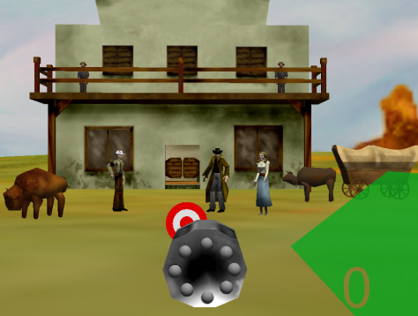
Step 4: Add Bullets to the Cylinder
Center the barrel on the bottom of the screen.
Turn the barrel to face PlayerView.
Rename the barrel “cylinder”.
Add a new SphereHighPoly to the Alice world, resize it, and move it into the top bullet position in the cylinder.
Rename the new SphereHighPoly “bullet1”.
Change the color of the bullet to gray.
Replicate the bullets, one for each position in the cylinder.

Slide 6
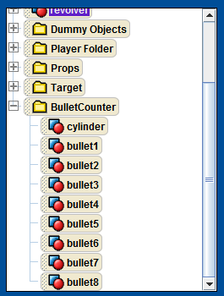
Step 5: Organize the Bullets and Cylinder
Make sure that the bullets are numbered 1 through 8, starting with the top bullet, in clockwise direction.
Create a new folder in the object tree named “BulletCounter”.
Add the bullets to the BulletCounter folder.
Add the cylinder to the BulletCounter.

Slide 7
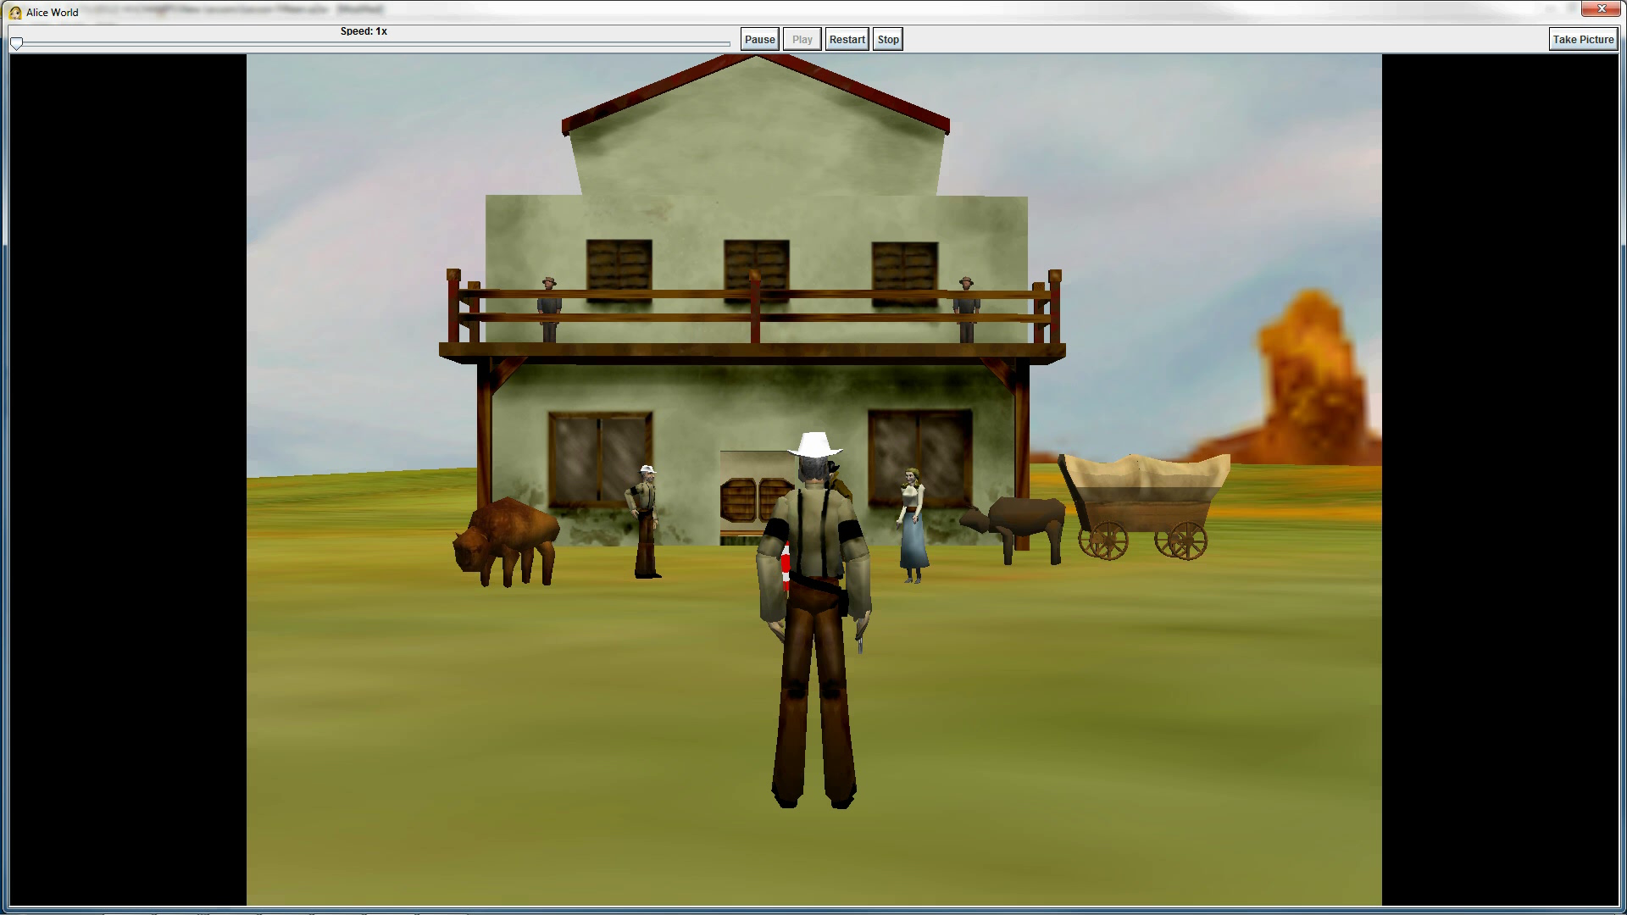
Final Scene

